Slide 1
Azure Cosmos Database
Nagesh Sathrasala

Slide 2

Your Instructor
Always available to support and answer your questions.
Nagesh Sathrasala
Nagesh.sathrasala@gmail.com
Database and cloud Architect, Developer and DBA.

Slide 3
Overview
What is NoSQL?
Why NoSQL?
Evolution of Cosmos DB.

Slide 4









What is NoSQL
`

Slide 5



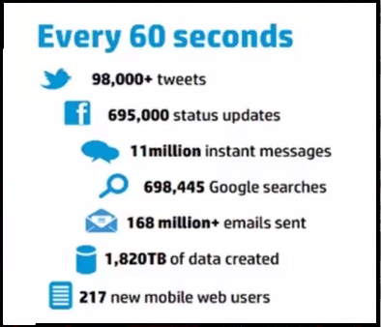
3 Vs of Big Data
Volume
Verity
Velocity

Slide 6
Cosmos DB Evolution
Internal Microsoft Document DB Service
Office, OneNote, Xbox
2010-2014
Azure Document DB preview
SQL grammar over schema-free JSON
• Tunable throughput, indexing, consistency
• Server-side ACID transactions
• Runs on Azure (fully managed PaaS)
Aug 21, 2014
Azure Document DB GA (General Availability)
Apr 8, 2015
New features
ORDER BY and string range queries
Geospatial support, SDK partitioning support
Aug 2015
New features
Partitioned collections, Geo-replication
Support for MongoDB (BSON)
Mar 31,2016
Notes:
Global Multi master regions, does not support for existing account as of now.

Slide 7
Cosmos DB Evolution
Azure Cosmos DB
Turnkey global distribution
Horizontal partitioning
Low latency (single-digit millisecond)
SLAs for guarantees on 99.99%
availability, throughput, latency, and consistency
Local emulator
Multi-model, multi-API database
JSON (SQL API)
BSON (MongoDB API)
Graph (Gremlin API)
Key-value (Table API)
Columnar (Cassandra API)
New features
Multi master and conflict resolution.
Reserved Capacity.
Cosmos Explorer.
99.999% write availability, all around the world.
Sharing provisioned throughput across multiple containers
May 10, 2017
2018
Notes:
Global Multi master regions, does not support for existing account as of now.

Slide 8
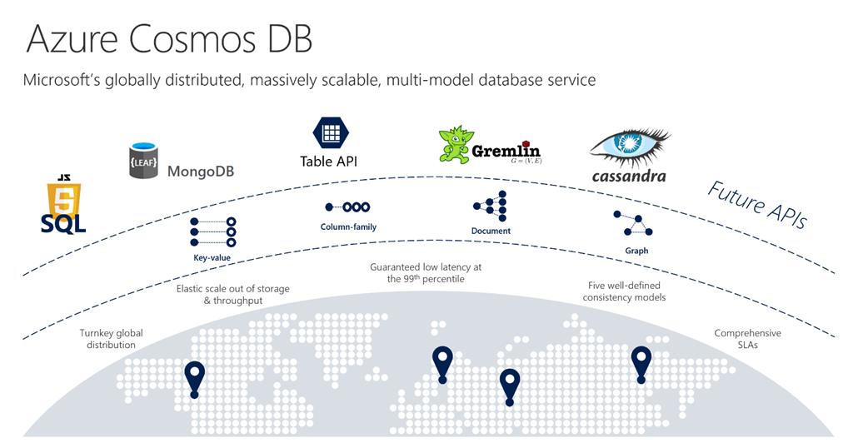
Cosmos Database
Evolution of Document DB
Multi Model API
Trunkey global distribution
Virtually unlimited Scale

Slide 9
Getting Started with Cosmos DB
Cosmos DB Key Capabilities.
Multiple API’s and Data Models
Demo: Creating Azure resource and Cosmos DB account
Demo: Local Emulator, how to install and use.
Demo: Creating Collections and documents

Slide 10
Cosmos DB Key Capabilities
Turnkey Global Distribution.
Multiple Data Models and popular API’s for accessing and querying data.
Elastically and independently scale throughput and storage .
Ensure always on availability
Multi master capabilities.
Write globally distributed application with 5 consistence models.
Best Industry SLA’s
Auto indexing and management.
Low cost.

Slide 11




Azure Cosmos DB Architecture
Document
SQL API (JSON)
MongoDB API (BSON)
Key-Value
Table API
(Replacement for Azure Table Storage)
Graph
Gremlin API
Columnar
Cassandra API
ARS (Atom, Record, Sequence)

Slide 12
Demo
Creating Azure resource and Cosmos DB account.
Local Emulator, how to install and use.
Creating Collections and documents
Notes:
Emulator: https://docs.microsoft.com/en-us/azure/cosmos-db/local-emulator
To generate demo data: https://www.generatedata.com/
Try cosmos DB for a month: aka.ms/trycosmosdb
Cosmos Explorer: https://cosmos.azure.com/

Slide 13
Performance and Throughput
How to measure Performance
What is RU.
Request units and charges.
Throughput isolation in globally distributed databases
Demo: How to Measure Required RU’s
Demo: Monitoring RU consumption and Alerts.
Demo: Allocating RU’s at both Database Collection level.
Estimating throughput needs

Slide 14
How to measure Performance
Latency
Latency talks how quickly you receive response for your request.
Throughput
Is all about how many concurrent transactions you can process within given period. Per sec within CosmosDB

Slide 15
What is RU
What happens when a request is send to Database?
CPU, disk, memory and network per 1 KB.
Number of RU’s Required depends on Document Size, complexity, indexing policy and Predicates we use.
Azure is transparent on RU’s used.
RU’s are deterministic.
Where to Provision RU’s.
What is Request Throttling.
Notes:
Request charged property of the response
Refused request response header. HTTP Status 429

Slide 16
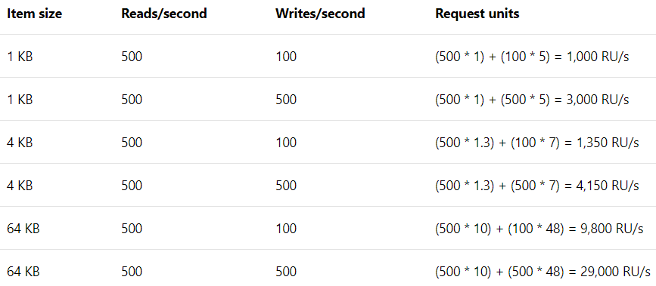
How to calculate RU’s
Estimating throughput needs
Application checklist
What does a typical item look like?
What are the typical queries that users will run?
How many writes per second are required?
How many queries per second are required?
What is the acceptable consistency level?
What is the indexing policy?
* Based on Session consistency indexing policy set to None.

Slide 17
Pricing
SSD Storage
Consumption based $0.25 per GB per month
Throughput
Reserved RU/Sec per hour
$0.0008 for 100 RU/Sec
Minimum allowed id 400 RU/Sec

Slide 18
Demo
How to Measure Required RU’s.
Monitoring RU consumption and Alerts.
Allocating RU’s at both Database Collection level.
Notes:
https://www.documentdb.com/capacityplanner
To generate demo data: https://www.generatedata.com/

Slide 19
Horizontal Partitioning and backup recovery
What is Partitioning.
Prerequisites for partitioning
Best practices when choosing a partition key.
Cross partition Queries and how to work with them.
Automatic backup restore with Azure DB.

Slide 20
What is Partitioning
Partition
Physical Fixed-capacity data store.
Massive Scale out within a Container.
Unlimited Auto scaled Containers
Logical Partition
Physical Partition
Container
Partition
Partition
Partition
Partition
Data
Data
Data
Data

Slide 21
Key Points Note Regarding Partitions
Unlimited number of partitions.
Fixed Sized SSD.
Auto Management of partitions.
Relationship between logical and physical partitions.

Slide 22
Prerequisites for partitioning
Unlimited sized containers
Unlimited sized Databases.

Slide 23
Best practices when choosing a partition key
How Cosmos DB knows where data is stored.
Choosing right partition key.
Best candidate for choosing right partition Key.
What is hot partition and how to avoid them.
The storage distribution is even across all the keys.
Choose a partition key that will evenly distribute data across partitions.

Slide 24
Benefits of Partitioning
Partition key values are hashed
One physical partition can host multiple partition keys.
Items with same partition key are stored together.
If appropriate predicates used in quires will help performance of all transactions.
Choose key such that storage or performance bottlenecks can be avoided.

Slide 25
Cross Partition Queries
Stored Procedures
Always scoped to a
single partition key
Queries
Typically scoped to a
single partition key
Cross-Partition
Queries
Span multiple
partition keys
Fan-out execution

Slide 26
Automatic backup and restore with Azure DB.
Every 4 hours backups
Backup to blob and replication.
RU’s for Backup
How to restore deleted containers.
How to restore Cosmos DB account.

Slide 27
Demo
How to work with cross partition quires.
Notes:
https://www.documentdb.com/capacityplanner

Slide 28
Summary
What is NOSQL and Why NOSQL is required.
Cosmos DB evolution.
How Cosmos DB supports multiple API’s.
what is RU and how it can be calculated.
Pricing and how it works.
Horizontal partitioning.
Backups.
Demo on Azure portal and other topics.

Slide 29
Data distribution
Introduction to data distributions
Different options available and Failover properties
Demo: Setting up geo replication and failover
Demo: Read write Geo replication (Preview).
Notes:
Day 2

Slide 30
Introduction to data distributions
Performance
Availability
Increased SLA’s
Notes:
https://uptime.is/

Slide 31
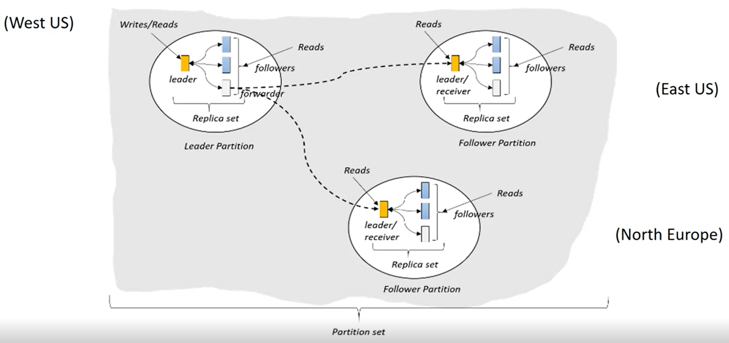
How replication works

Slide 32
Key benefits and Use cases
Key benefits
Single digit latency
5 9’s availability
Flexible conflict resolution
Tunable consistency
Implicit fault tolerance
Use Cases
Social Media apps
IoT
E-commerce
Metering and so on.

Slide 33
Different options available and Failover properties
Trunkey Global Distribution.
Policy-based Geo-fencing.
Multi-master and conflict resolution.
Last-writer-wins (LWW)
Custom – User-Defined Procedure
Custom – Asynchronous
Dynamically add and remove regions.
Multi-homing API.
Failover priorities.
Auto recovery of replication.

Slide 34
Demo
Setting up geo replication.
Setting up failover priorities.
Manual failover.
Multi Master replication.
.NET code to connect DB’s in replication and in multi master.
Notes:
https://www.documentdb.com/capacityplanner

Slide 35
Consistence levels.
Distributed databases and consistency.
Scope of consistency
Tunable consistency for globally replicated databases
Demo: how to switch between Consistence level.

Slide 36
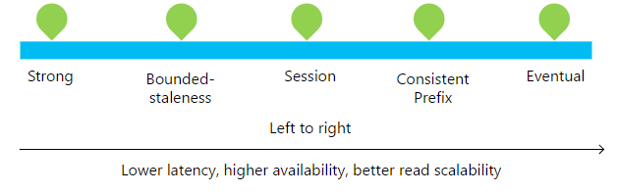
Distributed databases and consistency
How do you ensure consistent reads across replicas?
- Define a consistency level
Replication within a region
- Data moves extremely fast (typically, within 1ms) between neighboring racks
Global replication
- It takes hundreds of milliseconds to move data across continents

Slide 37
Scope of consistency
Value = 10
Value = 10
Update 10 → 5
Update 10 → 5
Value = 10
Notes:
Brewers CAP Theorem: What happens when failures occur.
PACELC Theorem

Slide 38
Tunable consistency models
Consistency Level | Guarantees | Dirty Reads
Strong | Linearizability. (Once operations completes, it will be visible to all) | No Dirty reads.
Bounded Staleness | Consistent Prefix. Reads lag behind writes by at most k prefixes or t interval | Dirty possible bounded by time and updates.
Session | Consistent Prefix. Monotonic reads, monotonic writes, read-your-writes, write-follows-reads | No dirty reads for writers Dirty reads possible for other users
Consistent Prefix | Reads will never see out of order writes (no gaps) | Dirty reads possible
Eventual | Potential for out of order reads. Lowes cost for reads of all consistency levels. | Stale reads possible No guaranteed order

Slide 39
Demo
How to switch between Consistence level in portal.
How to switch between consistence levels in .Net code.
Notes:
https://www.documentdb.com/capacityplanner

Slide 40
SQL API
Document Database
Difference between relational and Document DB
Cosmos DB Hierarchical resource model.
Recourse Prosperities, Self-Link and URI.
Data migration and Demo.

Slide 41
What is Document Database
Object graph
Semi-structured JSON
(JavaScript Object
Notation) documents
Two API
1) SQL API
2) MongoDB API

Slide 42
Difference between relational and Document DB
Relational Database | Document database
Rows | Documents
Document 1
{ data }
Table
Data
Data
Data
…
Document 2
{ data }
Row 1
Row 2
Row 3
…
Document 3
{ data }

Slide 43
Difference between relational and Document DB
Relational Database | Document database
Rows | Documents
Columns | Properties
Col1 | Col2 | Col2 | Col2
Data | Data | Data | Data
Data | Data | Data | Data
Data | Data | Data | Data
Data | Data | Data | Data
Document 1
{ "prop1": data, "prop2": data, "prop3": data, "prop4": data }
Document 2
{ "prop1": data, "prop2": data, "prop3": data, "prop4": data }
Document 3
{ "prop1": data, "prop2": data, "prop3": data, "prop4": data }

Slide 44
Difference between relational and Document DB
Relational Database | Document database
Rows | Documents
Columns | Properties
Predefined and strongly typed schema | Schema free
ID | Name | IsActive | Dob
1 | Black Smith | True | 8/25/1974
2 | Steve Jones | False | 2/15/2001
3 | Adam Clark | True | 7/16/1983
Document 1
{ "id": 1, "name": “Black Smith", "isActive": true, "dob": "1974-25-08" }
Document 2
{ "id": 2, "fullName": "Steve Jones", "dob": "2001-02-15" }
Document 3
{ "id": 3, “fullName": { "first": "Adam", "last": "Clark" }, "isActive": true, "dob": “1983-07-16" }

Slide 45
Difference between relational and Document DB
Relational Database | Document database
Rows | Documents
Columns | Properties
Predefined and strongly typed schema | Schema free
Normalized | Typically deformalized
User Table
Document
{ "id": 1, "name": “Black Smith", "dob": "1974-30-08", "holdings": [ { "qty": 100, "symbol": “JSW" }, { "qty": 75, "symbol": “RIL" } ] }
ID | Name | IsActive | Dob
1 | Black Smith | True | 8/30/1974
Holdings Table
StockID | UserID | Qty | Symbol
1 | 1 | 100 | JSW
2 | 1 | 150 | RIL

Slide 46
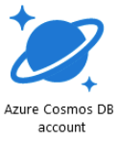
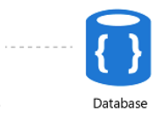
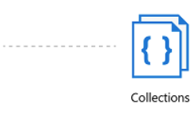
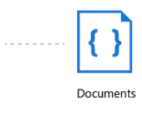
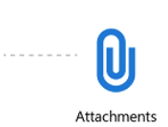
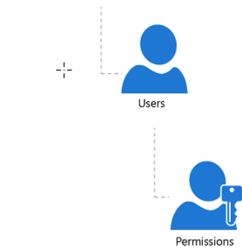
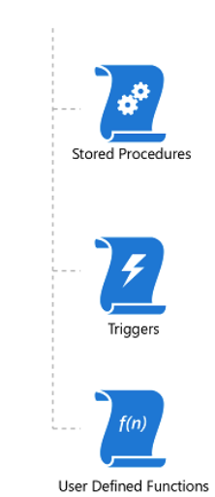
Cosmos DB Hierarchical resource model.

Slide 47
Recourse Prosperities, Self-Link and URI.
Every Resource contains these properties
Property | Value
Id | User-defined unique ID (string)
_rid | Resource ID
_ts | Timestamp (last updated) epoch value
_etag | GUID Used for optimistic concurrency
_self | URI path to the resource
_attachments | URI path suffix to the resource attachments
userDefinedId | Numerical value used for conflict resolution in multi master

Slide 48
Data migration tool and Demo
Data migration tool link.
Documentation and how to.
Source code on Git-hub
Import from:
SQL Server
JSON
CSV
MongoDB
Azure table
DynomoDB
Hbase
DcoumentDB
Export to:
JSON
DocumentDB
Notes:
Download link: http://www.microsoft.com/en-us/download/details.aspx?id=46436
How to: https://docs.microsoft.com/en-us/azure/cosmos-db/import-data
Source Code: https://github.com/Azure/azure-documentdb-datamigrationtool

Slide 49
SQL operators and functions
Built-in functions
Common operators
ABS, CEILING, EXP, FLOOR, LOG, LOG10,POWER, ROUND,SIGN, SQRT, SQUARE, TRUNC, ACOS, ASIN, ATAN, ATN2,COS, COT, DEGREES, PI, TAN RADIANS, SIN
Mathematical
Arithmetic
+ - * / %
Bitwise
| & ^ < >> >>>
IS_ARRAY, IS_BOOL, IS_NULL, IS_NUMBER, IS_OBJECT,IS_STRING,IS_DEFINED, IS_PRIMITIVE
Type Checking
Logical
AND, OR
CONCAT, CONTAINS, ENDSWITH, INDEX_OF, LEFT,LENGTH, LOWER, LTRIM, REPLACE, REPLICATE, REVERSE, RIGHT, RTRIM, UPPER, STARTSWITH, SUBSTRING, ToString, TRIM
Comparison
= <> > >= < <=
String Functions
Coalesce
? : ??
Array Functions
ARRAY_CONCAT, ARRAY_CONTAINS, ARRAY_LENGTH, ARRAY_SLICE
String
|| (concatenate)
Spatial
COUNT, SUM, MIN, MAX, AVG
Aggregate
ST_DISTANCE, ST_WITHIN, ST_INTERSECTS, ST_ISVALIDDETAILED

Slide 50
Demo
Importing data from SQL Server using Data migration tool.
Scaler expression quires.

Slide 51
Demo
Querying Documents in a Collection
Querying all Documents in a collection
Selecting particular columns and formatting. (including usage of value)
Querying sub documents and arrays.
Using from with in.
Joining Sub documents and arrays. (single and multiple joins)
Using Construct (Coalesce) within select.
String concatenation and Range queries and Sort. (difference ways of using between)
Boolean expression (on = comparison).
How to use IIF (Ternary ?) operator.
Using Aggregate functions.

Slide 52
Programming with .NET SDK
Introduction.
Working with .Net SDK for SQL API.
Demo: Querying Documents.
Demo: Replacing and deleting documents.
Demo: Working with users and permissions.
Notes:
Day 3

Slide 53
Introduction
Build web-scale
Applications
Uses REST/HTTP
SDKs
.NET / .NET Core
Java
Node.js
Python

Slide 54
Working with .Net SDK for SQL API
Create a DocumentClient instance
Supply connection information
(endpoint and key)
Invoke methods to access resources
Create, modify, and delete resources
Use POCOs or dynamics for document objects
Task Parallel Library (TPL)
Simplified asynchronous programming
Use async/await wait keywords with Task objects

Slide 55
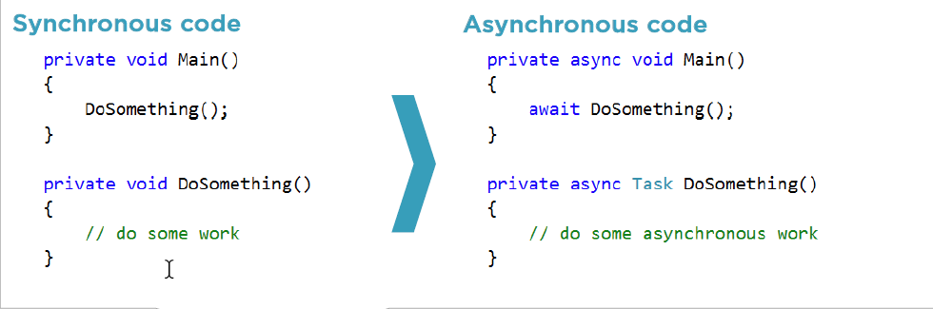
Working with .Net SDK for SQL API
Create a DocumentClient instance
Supply connection information
(endpoint and key)
Invoke methods to access resources
Create, modify, and delete resources
Use POCOs or dynamics for document objects
Task Parallel Library (TPL)
Simplified asynchronous programming
Use async/await keywords with Task objects

Slide 56
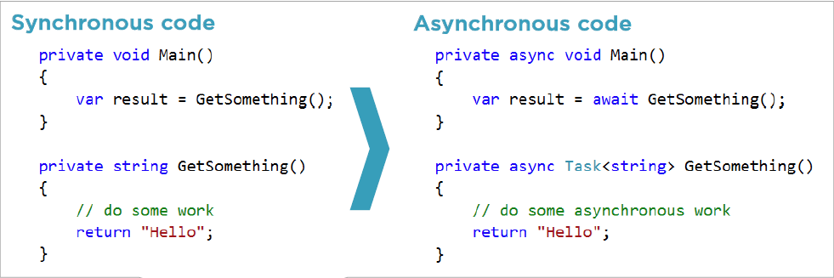
Working with .Net SDK for SQL API
Create a DocumentClient instance
Supply connection information
(endpoint and key)
Invoke methods to access resources
Create, modify, and delete resources
Use POCOs or dynamics for document objects
Task Parallel Library (TPL)
Simplified asynchronous programming
Use async/await keywords with Task objects

Slide 57
Working with .Net SDK for SQL API
Create a DocumentClient instance
Supply connection information
(endpoint and key)
Invoke methods to access resources
Create, modify, and delete resources
Use POCOs or dynamics for document objects
Task Parallel Library (TPL)
Simplified asynchronous programming
Use async/await keywords with Task objects
LINQ provider
Automatically translates LINQ queries to SQL

Slide 58
Demo
Getting Started with .NET SDK
Working with Databases.
Working with Collections.
Creating documents.
Querying for documents.
Updating and Deleting documents.
Notes:
Plain Old CLR Objects (POCO)

Slide 59
Indexing in Cosmos Database.
Introduction.
Indexing Policies Index management.
Demo: Creating different types of indexes.
Demo on Indexes

Slide 60
Introduction
Key benefits of indexes
Hash Index
Good for equality queries of strings and numbers
Range Index
Good for Equality, Range, order by of strings and numbers.
Spatial Index
Used with Distance and intersection points, polygons and line strings.

Slide 61
Demo
Check on portal or Emulator.
Notes:
Plain Old CLR Objects (POCO)

Slide 62
Indexing Policies Index management.
Collection-wide policy
Established when creating a collection
Can be changed after collection is created
Automatic indexing
Can switch to manual
Can override on a per-document basis
Selective indexing
Include/exclude selected property paths
Individual properties (?) Recursive properties (*)
/name/? /address/*
/address/state/? /item/colors[]/*

Slide 63
Indexing Policies Index management.
Collection-wide policy
Established when creating a collection
Can be changed after collection is created
Automatic indexing
Can switch to manual
Can override on a per-document basis
Selective indexing
Include/exclude selected property paths
Indexing modes
Consistent (synchronous)
Lazy (asynchronous)

Slide 64
Demo
Disabling of indexing while inserting a document.
Over writing default indexing policy.
Custom indexing paths.
Working with user Permissions.

Slide 65
Stored procedures, Functions and Triggers
Introduction
Benefits of server side code.
Demo: Stored procedures.
Demo: Function.
Demo: Triggers.

Slide 66
Introduction and Benefits of server side code.
Run code inside Cosmos DB
Stored procedures
Triggers
User-defined functions
Scoped by partition key
Read/write documents with that partition key
Fully transactional updates (ACID guarantee)
Bounded execution
Implement continuation model
for long running processes
Handle throttling (code 429)
Implement retry logic when
exceeding reserved throughput

Slide 67
Stored procedures
Write a JavaScript function
Obtain context object
Context exposes
Collection
Request
Response

Slide 68
Demo
Creating Stored procedures
Document validation and manipulation Stored procedure.
Bulk Insert Stored procedure
Bulk delete stored procedure

Slide 69
Working with Triggers
Attach custom behavior
Access document being
created or replaced
Two trigger types
Pre-trigger
Post-trigger
Not fired automatically
Must be explicitly
requested with an
operation

Slide 70
Demo
Creating Triggers
Pre-triggers
Post-triggers

Slide 71
Working with Functions
Extend the query language
Write custom business logic that can be called from inside queries
Use with care
Querying on a UDF requires a scan (cannot use index)
No access to context
Compute-only
JavaScript

Slide 72
Demo
User-Defined Functions (UDFs)

Slide 73
Understand Table API
Introduction
How data is stored and how is it different from SQL API.
Demo: Working with Table API.
Demo: Migrating data from Azure Table store to Table API or Azure Cosmos DB
Notes:
Day 3

Slide 74
Introduction
Replaces Azure Table storage.
Implement a key-value data model
Key-value data model.
Key = PartitionKey + RowKey
Value = key-value pairs!
Leverage Cosmos DB back end.
Predictable throughput
Global distribution
Automatic indexing
Notes:
Day 3

Slide 75
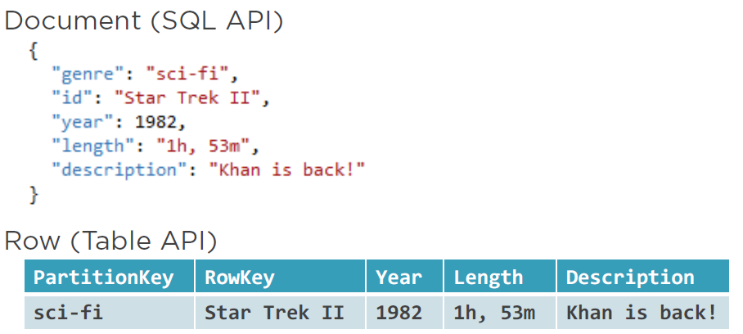
SQL API vs. Table API
Cosmos DB | SQL API | Table API
Container | Collection | Table
Iteam | Document | Row
Partition Key | Any property | PartitionKey
ID | Id | RowKey
Notes:
Day 3

Slide 76
Understand and usage of Graph API
Introduction Graph API.
Different concepts.
Comparison between 3 models.
Demo: Working with Graph DB.
Notes:
Day 3

Slide 77
Introduction Graph API.
Graph container.
Horizontal partitioning, provisioned throughput, global distribution, indexing
Vertex and Edge objects.
Entities and relationships
Both can hold arbitrary key-value pairs
Create/Retrieve/Update/Delete.
GraphSON and Gremlin
Apache TinkerPop (http://tinkerpop.apache.org)
Focus on relationships.
Chain relationship queries with Gremlin.
Vertex and Edge properties.
id (within partition key) label (type). Additional arbitrary properties (including the partition key).
Additional Edge properties.
Cardinality (in-and-out vertices) and Create two edges for bi-directionality
Notes:
Day 3

Slide 78
Where it suites best
Complex relationships.
Many “many-to-many” relationships
Excessive JOINs
Analyze interconnected data and relationships
Typical graph applications.
Social networks
Recommendation engines
Knowledge graphs
Many more…
Notes:
Day 3

Slide 79
Summary and what is next

